Slide 1

Git vs SVN
May 17th, 2016
TMA Solutions
www.tmasolutions.com

Slide 2
CONTENTS
1. Comparison of Git and SVN
2. Why use SVN?
3. Why use Git?
4. Q&A

Slide 3
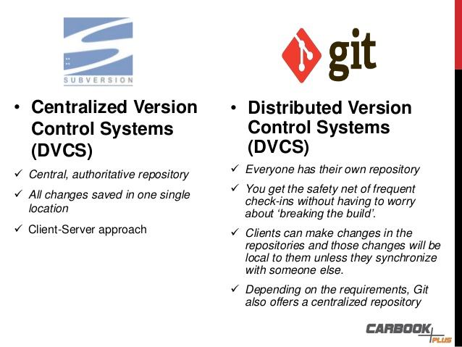

Slide 4
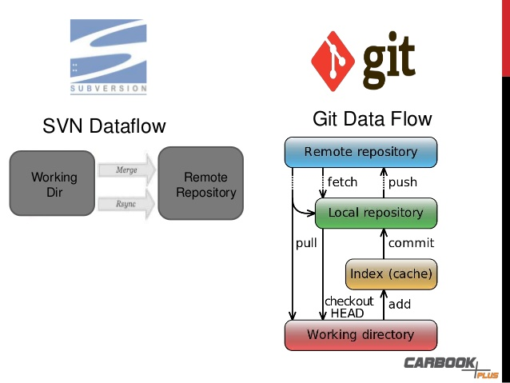

Slide 5
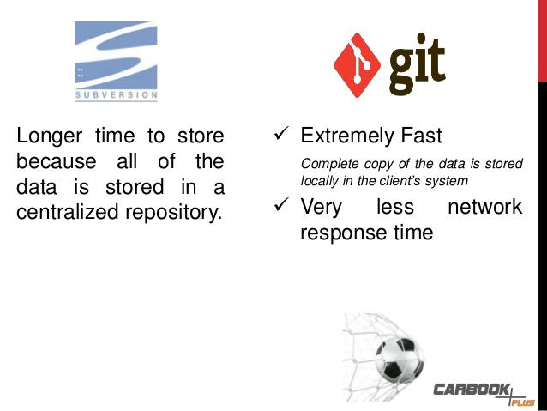

Slide 6
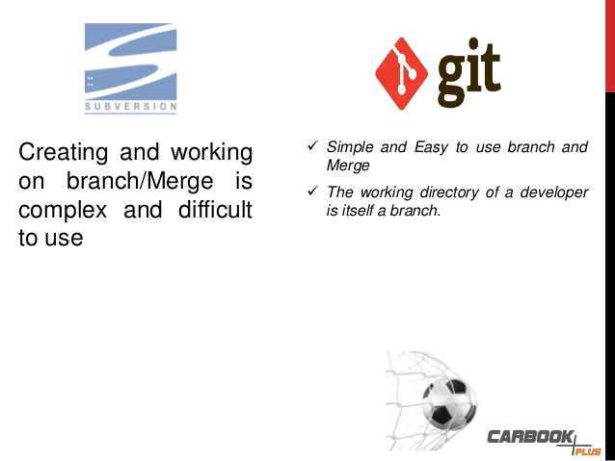

Slide 7
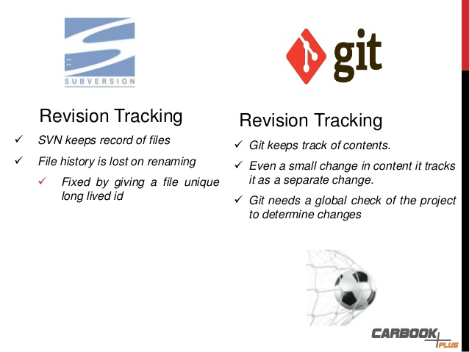

Slide 8
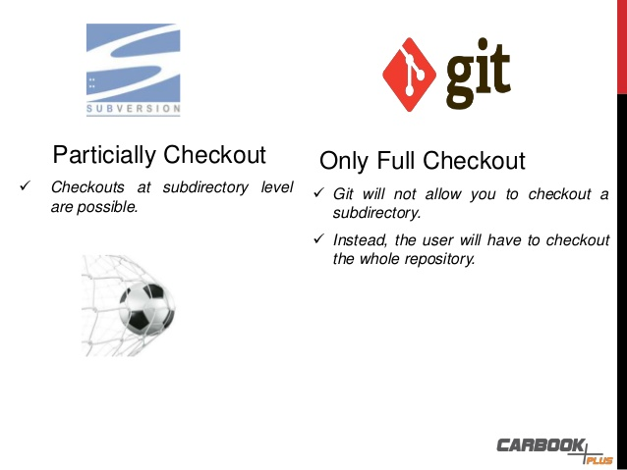

Slide 9
Why use SVN?
Simpler to learn
Encourages a simple central repository model and don’t branch very much
Code check-in conflicts do not occur very often
Checkout grabs the subdirectory only, but git clones the entire repository

Slide 10
Why use Git?
Can work offline
Speed
Less storage space
Simple and easy to use branch and merge

Slide 11
Q&A

Slide 12
Thank you

